Slide 1
ModuleIII
Transaction Management & concurrency control

Slide 2
Transactions
Collections of operations that form a single logical unit of work are called transactions.
A database system must ensure proper execution of transactions despite failures—either the entire transaction executes, or none of it does.
Transaction is a unit of program execution that accesses and possibly updates various data items.

Slide 3
What is a Transaction?
Any action that reads from and/or writes to a database may consist of
Simple SELECT statement to generate a list of table contents
A series of related UPDATE statements to change the values of attributes in various tables
A series of INSERT statements to add rows to one or more tables
A combination of SELECT, UPDATE, and INSERT statements

Slide 4
What is a Transaction?
A logical unit of work that must be either entirely completed or aborted
Successful transaction changes the database from one consistent state to another
One in which all data integrity constraints are satisfied
Most real-world database transactions are formed by two or more database requests
The equivalent of a single SQL statement in an application program or transaction

Slide 5
Evaluating Transaction Results
Not all transactions update the database
SQL code represents a transaction because database was accessed
Improper or incomplete transactions can have a devastating effect on database integrity
Some DBMSs provide means by which user can define enforceable constraints based on business rules
Other integrity rules are enforced automatically by the DBMS when table structures are properly defined, thereby letting the DBMS validate some transactions

Slide 6
Transaction Properties(ACID properties)
Atomicity
Requires that all operations (SQL requests) of a transaction be completed; if not, then the transaction is aborted
A transaction is treated as a single, indivisible, logical unit of work
This “all-or-none” property is referred to as atomicity.
Consistency
Consistency property ensures that the database must remain in the consistent state before the start of transaction and after the transaction is over.
Consistency states that only valid data will be written to the database.
If for some reason a transaction is executed that violates the database consistency rules the entire transaction will be rolled back.

Slide 7
Isolation
Data used during execution of a transaction cannot be used by second transaction until first one is completed
Even though multiple transactions may execute concurrently, the system guarantees that, for every pair of transactions Ti and Tj , it appears to Ti that either Tj finished execution before Ti started, or Tj started execution after Ti finished.

Slide 8
Durability
After a transaction completes successfully, the changes it has made to the database persist, even if there are system failures.
Durability can be implemented by writing all transaction into a transaction log that can be used to crate a system state right before failure.
A transaction can only regard as committed after it is written safely in the log.
For example, in an application that transfers funds from one account to another, the durability property ensures that the changes made to each account will not be reversed.
These properties are called the ACID properties.

Slide 9
Transaction State
A transaction must be in one of the following states:
Active:-
The initial state; the transaction stays in this state while it is executing.
Partially committed:-
After the final statement has been executed.
Failed:-
After the discovery that normal execution can no longer proceed.

Slide 10
Transaction State
Aborted:-
After the transaction has been rolled back and the database has been restored to its state prior to the start of the transaction
Committed:-
After successful completion

Slide 11
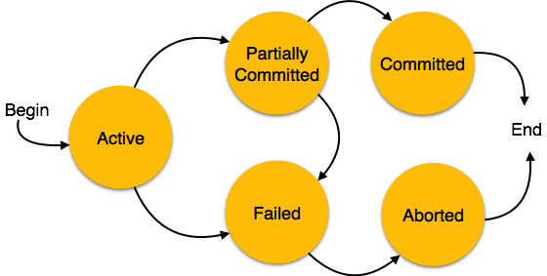

Slide 12
Transaction Management with SQL
ANSI has defined standards that govern SQL database transactions
Transaction support is provided by two SQL statements: COMMIT and ROLLBACK
ANSI standards require that, when a transaction sequence is initiated by a user or an application program,it must continue through all succeeding SQL statements until one of four events occurs

Slide 13
Transaction Management with SQL
A COMMIT statement is reached- all changes are permanently recorded within the database
A ROLLBACK is reached – all changes are aborted and the database is restored to a previous consistent state
The end of the program is successfully reached – equivalent to a COMMIT
The program abnormally terminates and a rollback occurs

Slide 14
The Transaction Log
Keeps track of all transactions that update the database. It contains:
A record for the beginning of transaction
For each transaction component (SQL statement)
Type of operation being performed (update, delete, insert)
Names of objects affected by the transaction (the name of the table)
“Before” and “after” values for updated fields
Pointers to previous and next transaction log entries for the same transaction
The ending (COMMIT) of the transaction
Increases processing overhead but the ability to restore a corrupted database is worth the price

Slide 15
The Transaction Log
Increases processing overhead but the ability to restore a corrupted database is worth the price
If a system failure occurs, the DBMS will examine the log for all uncommitted or incomplete transactions and it will restore the database to a previous state
The log it itself a database and to maintain its integrity many DBMSs will implement it on several different disks to reduce the risk of system failure

Slide 16
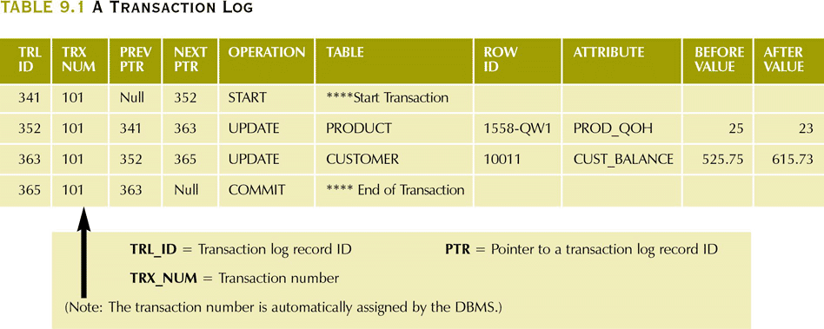
A Transaction Log

Slide 17
Transactions and schedules
A transaction is seen by the dbms as a series or list of actions.
Actions include read and writes of database object.
Assume that an object O is always read into a program variable that is also named O
Denote transaction T reading an object O as R_{T}(O)
Similarly writing as W_{T}(O)

Slide 18
Each transaction must specify as its final action either commit or abort
Abort_{T} and Commit_{T}
Schedule is a list of actions from a set of transactions,
Schedule represents an actual or potential execution sequence.

Slide 19
T1 T2
R(A)
W(A)
R(B)
W(B)
R(C)
W(C)

Slide 20
A schedule that contains either abort or commit for each transactions is called complete schedule.
If transactions are executed from start to finish,one by one----serial schedule

Slide 21
Concurrent execution of Transactions
Transaction processing system usually allow multiple transaction to run concurrently.
Allowing multiple transaction to run concurrently and allowing multiple transaction to update data concurrently causes several complications with consistency of data.
Ensuring consistency with concurrency require an extra work.

Slide 22
Concurrent execution of Transactions
Two reasons to allow concurrency are:-
Improve throughput and resource utilization:-(Throughput – Number of transactions that can be executed in a given amount of time.)
Reduced waiting time.

Slide 23
There may be a mix of transactions running on a system, some short and some long.
If transactions are run serially, a short transaction may have to wait for a preceding long transaction to complete, which can lead to unpredictable delays in running a transaction.
But concurrent execution reduces the unpredictable delays in running transactions.

Slide 24
TYPES OF SCHEDULE
1. Serial Schedule
2. Non-serial Schedule
3. Serializable schedule

Slide 25
1. Serial Schedule
The serial schedule is a type of schedule where one transaction is executed completely before starting another transaction.
In the serial schedule, when the first transaction completes its cycle, then the next transaction is executed.
For example: Suppose there are two transactions T1 and T2 which have some operations.

Slide 26
Execute all the operations of T1 which was followed by all the operations of T2.
Execute all the operations of T2 which was followed by all the operations of T1.
In the given (a) figure, Schedule A shows the serial schedule where T1 followed by T2.
In the given (b) figure, Schedule B shows the serial schedule where T2 followed by T1.

Slide 27
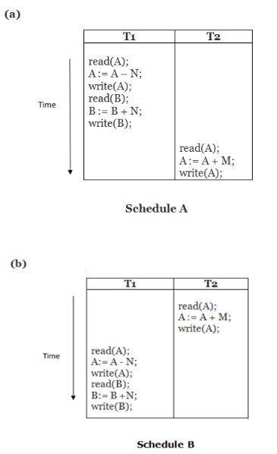
If it has no interleaving of operations, then there are the following two possible outcomes:

Slide 28
2. Non-serial Schedule/ Concurrent Execution
If interleaving of operations is allowed, then there will be non-serial schedule.
It contains many possible orders in which the system can execute the individual operations of the transactions.
In the given figure (c) and (d), Schedule C and Schedule D are the non-serial schedules. It has interleaving of operations.

Slide 29
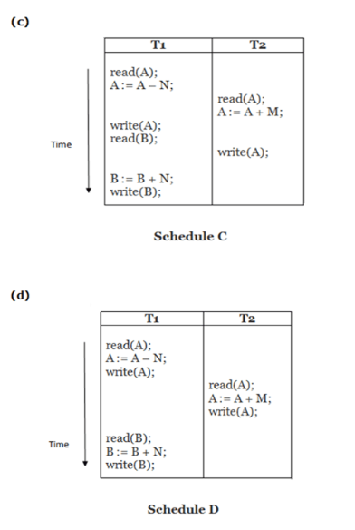
Non-serial Schedule

Slide 30
Problems with Concurrent Execution
In a database transaction, the two main operations are READ and WRITE operations. So, there is a need to manage these two operations in the concurrent execution of the transactions.
following problems occur with the Concurrent Execution of the operations:
Problem 1: Lost Update Problems (W - W Conflict)
Dirty Read Problems (W-R Conflict)
Unrepeatable Read Problem (W-R Conflict)/ Inconsistent Retrievals Problem

Slide 31
Problem 1: Lost Update Problems (W - W Conflict)
The problem occurs when two different database transactions perform the read/write operations on the same database items in an interleaved manner (i.e., concurrent execution) that makes the values of the items incorrect hence making the database inconsistent.
Consider the below diagram where two transactions T_{X} and T_{Y}, are performed on the same account A where the balance of account A is $300.

Slide 32
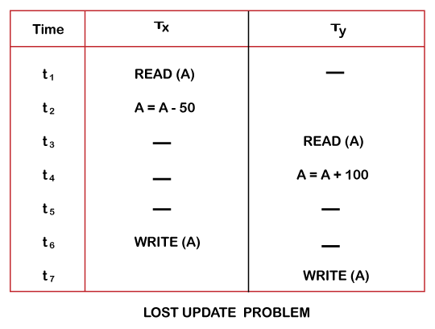

Slide 33
At time t1, transaction T_{X} reads the value of account A, i.e., $300 (only read).
At time t2, transaction T_{X} deducts $50 from account A that becomes $250 (only deducted and not updated/write).
Alternately, at time t3, transaction T_{Y} reads the value of account A that will be $300 only because T_{X} didn't update the value yet.
At time t4, transaction T_{Y} adds $100 to account A that becomes $400 (only added but not updated/write).
At time t6, transaction T_{X} writes the value of account A that will be updated as $250 only, as T_{Y} didn't update the value yet.
Similarly, at time t7, transaction T_{Y} writes the values of account A, so it will write as done at time t4 that will be $400. It means the value written by T_{X} is lost, i.e., $250 is lost.
Hence data becomes incorrect, and database sets to inconsistent.

Slide 34
Dirty Read Problems (W-R Conflict) / Uncommitted Data
The dirty read problem occurs when one transaction updates an item of the database, and somehow the transaction fails, and before the data gets rollback, the updated database item is accessed by another transaction. There comes the Read-Write Conflict between both transactions.

Slide 35
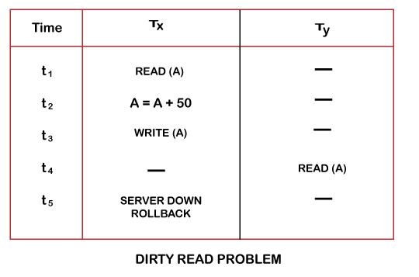

Slide 36
At time t1, transaction T_{X} reads the value of account A, i.e., $300.
At time t2, transaction T_{X} adds $50 to account A that becomes $350.
At time t3, transaction T_{X} writes the updated value in account A, i.e., $350.
Then at time t4, transaction T_{Y} reads account A that will be read as $350.
Then at time t5, transaction T_{X} rollbacks due to server problem, and the value changes back to $300 (as initially).
But the value for account A remains $350 for transaction T_{Y} as committed, which is the dirty read and therefore known as the Dirty Read Problem.

Slide 37
Unrepeatable Read Problem (W-R Conflict) / Inconsistent Retrievals Problem
Also known as Inconsistent Retrievals Problem that occurs when in a transaction, two different values are read for the same database item.

Slide 38
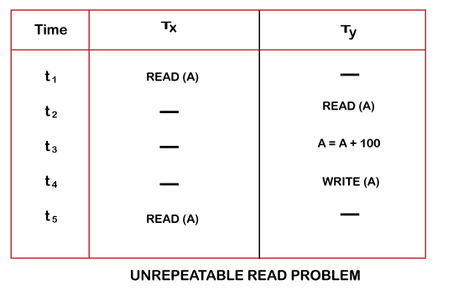

Slide 39
Serializability
When multiple transactions run concurrently, then it may give rise to inconsistency of the database.
Serializability is a concept that helps to identify which non-serial schedules are correct and will maintain the consistency of the database.
If a given schedule of ‘n’ transactions is found to be equivalent to some serial schedule of ‘n’ transactions, then it is called as a serializable schedule.

Slide 40
Difference between Serial Schedules and Serializable Schedules-
The only difference between serial schedules and serializable schedules is that-
In serial schedules, only one transaction is allowed to execute at a time i.e. no concurrency is allowed.
Whereas in serializable schedules, multiple transactions can execute simultaneously i.e. concurrency is allowed.

Slide 41
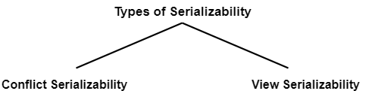
Types of Serializability

Slide 42
Conflict Serializability
A schedule is called conflict serializable if it can be transformed into a serial schedule by swapping non-conflicting operations.
Let us consider a schedule S in which there are two consecutive instructions ,I_{i} and I_{j} of transactions T_{i} and T_{j} ,respectively(i!=j).

Slide 43
If I_{i} and I_{j} refer to different data items ,then we can swap I_{i} and Ij ,without affecting the results of any instruction in the schedule.
However ,if Ii and Ij refer to the same data item Q,then the order of the two steps may matter.

Slide 44
There are four cases we need to consider
Ii=read(Q) ,Ij =read(Q), the order of Ii and Ij does not matter
Ii=read(Q) ,Ij =Write(Q),
If Ii comes before Ij ,then Ti doesnot read the value of Q that is written by Tj in instruction Ij.thus the order of Ii and Ij matters
Ii=Write(Q) ,Ij =read(Q), the order of Ii and Ij matter
Ii=write(Q) ,Ij =write(Q), the order of Ii and Ij does not matter,how ever the value obtained by the next read(Q)instn is affected.

Slide 45
If a schedule S can be transformed into a schedule S’ by a series of swaps of non-conflicting instructions ,we say that S and S’ are conflit equivalent.
A Schedule S is conflict serializable if it is conflict equivalent

Slide 46
A schedule is called conflict serializable if it can be transformed into a serial schedule by swapping non-conflicting operations.
Two operations are said to be conflicting if all conditions satisfy:
They belong to different transactions
They operate on the same data item
At Least one of them is a write operation

Slide 47
Precedence Graph
Precedence Graph or Serialization Graph is used commonly to test Conflict Serializability of a schedule.
It is a directed Graph (V, E) consisting of a set of nodes V = {T₁, T₂, T₃……….T_{n}} and a set of directed edges E = {e₁, e₂, e₃………………e_{m}}.

Slide 48
The graph contains one node for each Transaction T_{i}.
An edge e_{i} is of the form T_{j} –> T_{k.}
where T_{j} is the starting node of e_{i} and T_{k} is the ending node of e_{i}.
An edge e_{i} is constructed between nodes T_{j} to T_{k} if one of the operations in T_{j} appears in the schedule before some conflicting operation in T_{k} .

Slide 49
ALGORITHM
Create a node T in the graph for each participating transaction in the schedule.
Check for conflicting instructions in the schedule:-
For the conflicting operation read_item(X) and write_item(X)(RW Conflict) – If a Transaction Ti executes a read_item (X) after Tj executes a write_item (X), draw an edge from Ti to Tj in the graph.
For the conflicting operation write_item(X) and read_item(X)(i.e WR conflict) – If a Transaction Ti executes a write_item (X) after Tj executes a read_item (X), draw an edge from Ti to Tj in the graph.

Slide 50
ALGORITHM
For the conflicting operation write_item(X) and write_item(X) (i.e WW conflict)– If a Transaction Tj executes a write_item (X) after Ti executes a write_item (X), draw an edge from Ti to Tj in the graph.
The Schedule S is serializable if there is no cycle in the precedence graph.
If there is no cycle in the precedence graph, it means we can construct a serial schedule S’ which is conflict equivalent to the schedule S.

Slide 51

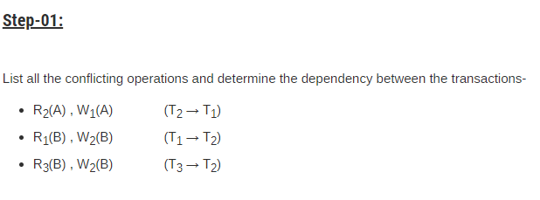
PROBLEM 1
SOLUTION

Slide 52
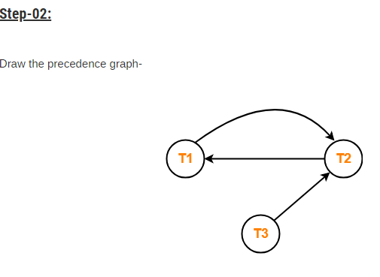
Clearly, there exists a cycle in the precedence graph.
Therefore, the given schedule S is not conflict serializable.

Slide 53
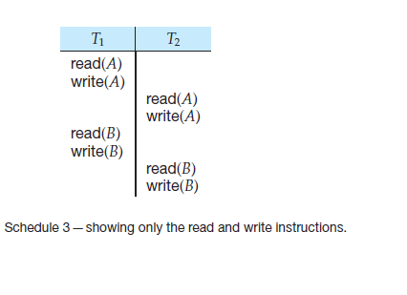
Example: conflict serializable and conflict equivalent

Slide 54
CONFLICT EQUIVALENT
Using precedence graph we found that the schedule 3 is conflict serializable since no cycles formed in graph.
If a schedule S can be transformed into a schedule S’ by a series of swapping of non conflicting instruction ,then we can say S and S’ are conflict equivalent.
Adjacent non conflicting pairs are swapped by position

Slide 55
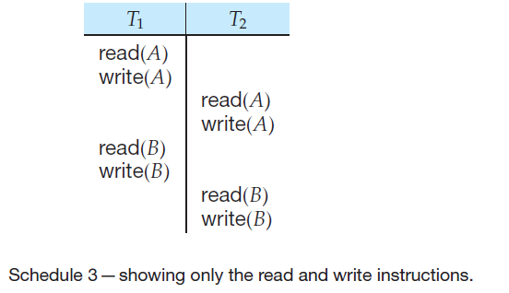
Example :CONFLICT EQUIVALENT
Consider schedule 3 which is conflict serializable.

Slide 56
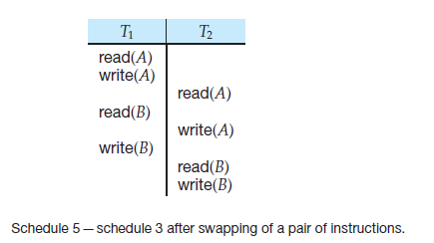
Example :conflict equivalent(conti..)
To find the conflict equivalent of the schedule 3 we need to perform certain swapping, i.e swapping of positions of non conflicting adjacent instructions in T1 and T2

Slide 57
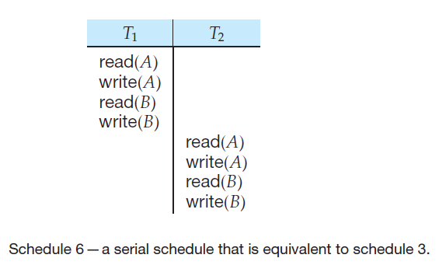
Example :conflict equivalent(conti..)
After a series of swapping we will get a serial schedule which is conflict equivalent of schedule 3.

Slide 58
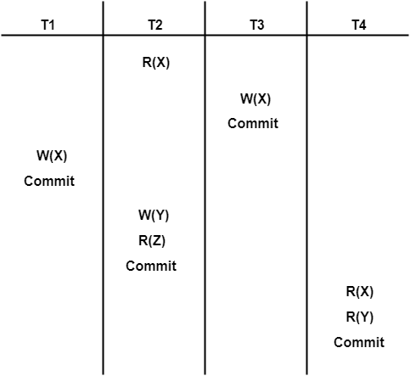

Slide 59
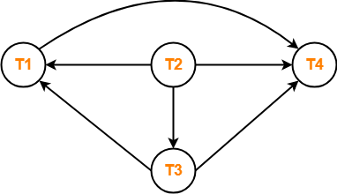

Slide 60
Question: Consider the following schedules involving two transactions. Which one of the following statement is true?
S1: R₁(X) R₁(Y) R₂(X) R₂(Y) W₂(Y) W₁(X) S2: R₁(X) R₂(X) R₂(Y) W₂(Y) R₁(Y) W₁(X)
Both S1 and S2 are conflict serializable
Only S1 is conflict serializable
Only S2 is conflict serializable
None

Slide 61
Only S2 is conflict serializable.

Slide 62
View Serializability
If a given schedule is found to be view equivalent to some serial schedule, then it is called as a view serializable schedule.

Slide 63
View Equivalent Schedules-
Consider two schedules S1 and S2 each consisting of two transactions T1 and T2.
Two schedules S1 and S2 are said to be view equivalent if below conditions are satisfied .
1. Initial Read
2. Updated Read
3. Final Write

Slide 64
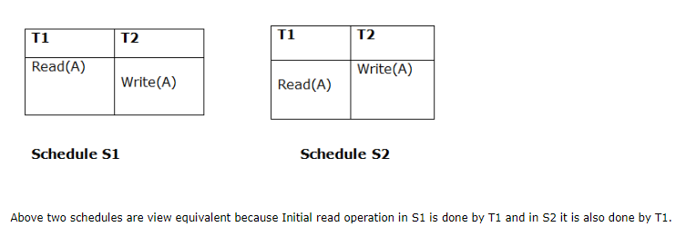
1. Initial Read
An initial read of both schedules must be the same. Suppose two schedule S1 and S2. In schedule S1, if a transaction T1 is reading the data item A, then in S2, transaction T1 should also read A.

Slide 65
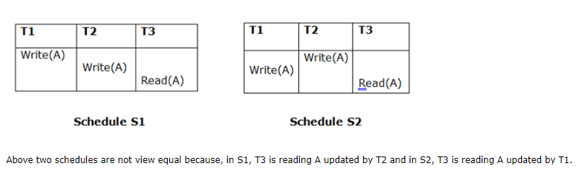
2. Updated Read
In schedule S1, if Ti is reading A which is updated by Tj then in S2 also, Ti should read A which is updated by Tj.

Slide 66
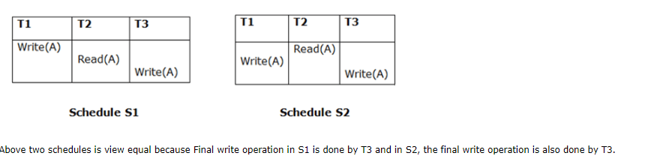
3. Final Write
A final write must be the same between both the schedules. In schedule S1, if a transaction T1 updates A at last then in S2, final writes operations should also be done by T1.

Slide 67
Condition 1 and 2 ensure that each transaction reads the same value in both schedules S1 and S2(so perform same computation).
Condition 3 together with conditions 1 and 2 ensures both schedules result in same final state.

Slide 68
Every conflict serializable schedule is also view serializable .
But all view serializable are not conflict serializable.
Blind writes appear in any view serializable schedule that is not conflict serializable.

Slide 69
View serializability
If a given schedule is found to be view equivalent to some serial schedule, then it is called as a view serializable schedule..
Consider two schedules S1 and S2 each consisting of two transactions T1 and T2. Schedules S1 and S2 are called view equivalent if the following three conditions hold true for them-

Slide 70
1.For each data item Q,if transaction T_{i} reads the initial value of Q in schedule S,then transaction T_{i} must in schedule S’’ also read the initial value of Q.
“Initial reads must be same for all data items”
If transaction T_{i} reads a data item that has been updated by the transaction T_{j} in schedule S1, then in schedule S2 also, transaction T_{i} must read the same data item that has been updated by transaction T_{j.}
“Write-read sequence must be same.”.

Slide 71
For each data item Q ,the transaction that perform the final write(Q) operation in schedule S must perform the final Write(Q) operation in schedule in S”.
“Final writers must be same for all data items”.

Slide 72
How to check whether a given schedule is view serializable or not?
Method-01:
Check whether the given schedule is conflict serializable or not.
If the given schedule is conflict serializable, then it is surely view serializable.
If the given schedule is not conflict serializable, then it may or may not be view serializable. Go and check using other methods.

Slide 73
Method-02:
Check if there exists any blind write operation (writing without reading a value is known as a blind write).
If there does not exist any blind write, then the schedule is surely not view serializable. Stop and report your answer.
If there exists any blind write, then the schedule may or may not be view serializable. Go and check using other methods.

Slide 74
Method-03:
In this method, try finding a view equivalent serial schedule.

Slide 75
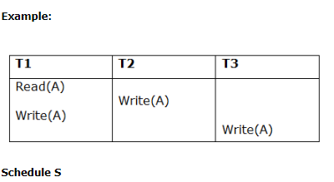
EXAMPLE :
To check whether S is view serializable:-

Slide 76
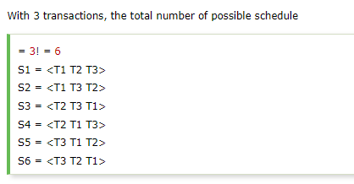
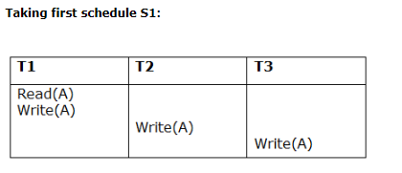
EXAMPLE:SOLUTION

Slide 77
EXAMPLE:- solution
Step 1: final updation on data items
In both schedules S and S1, there is no read except the initial read that's why we don't need to check that condition.
Step 2: Initial Read
The initial read operation in S is done by T1 and in S1, it is also done by T1.
Step 3: Final Write
The final write operation in S is done by T3 and in S1, it is also done by T3. So, S and S1 are view Equivalent.

Slide 78
EXAMPLE:-SOLUTION (conti..)
The first schedule S1 satisfies all three conditions, so we don't need to check another schedule.
Hence, view equivalent serial schedule of S is S1:
T1 → T2→ T3

Slide 79
Irrecoverable Schedules-
If in a schedule,
A transaction performs a dirty read operation from an uncommitted transaction
And commits before the transaction from which it has read the value then such a schedule is known as an Irrecoverable Schedule.

Slide 80
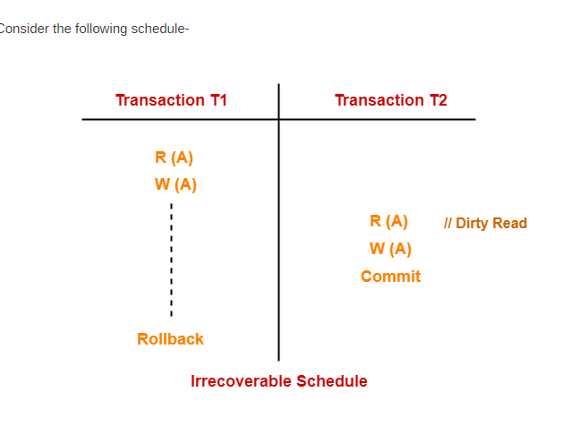
Example:Irrecoverable schedule

Slide 81
Example: Irrecoverable schedule
In the above example
T2 performs a dirty read operation.
T2 commits before T1.
T1 fails later and roll backs.
The value that T2 read now stands to be incorrect.
T2 can not recover since it has already committed.
So the above schedule is an irrecoverable schedule.

Slide 82
Recoverable Schedules-
If in a schedule,
A transaction performs a dirty read operation from an uncommitted transaction.
And its commit operation is delayed till the uncommitted transaction either commits or roll backs then such a schedule is known as a Recoverable Schedule.

Slide 83
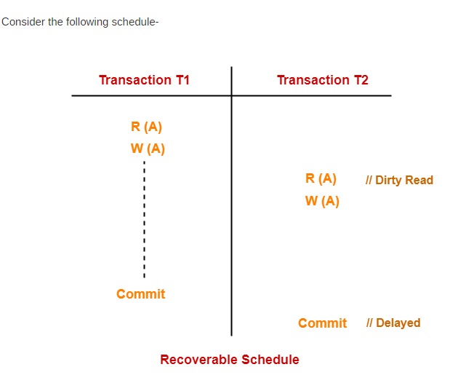
EXAMPLE: Recoverable Schedules-

Slide 84
In the above example T2 performs a dirty read operation.
The commit operation of T2 is delayed till T1 commits or roll backs.
T1 commits later.
T2 is now allowed to commit.

Slide 85
In case, T1 would have failed, T2 has a chance to recover by rolling back.
Since the commit operation of the transaction that performs the dirty read is delayed.
This ensures that it still has a chance to recover if the uncommitted transaction fails later.

Slide 86
Recoverable schedule
Two types:
Cascadeless schedule
Cascading schedule

Slide 87
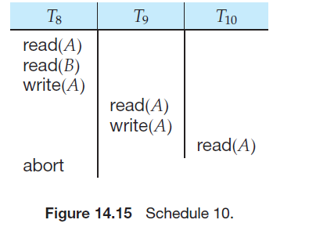
CASCADING SCHEDULE
Even if a schedule is recoverable ,to recover correctly from failure of transaction Ti, we may have to roll back several transaction.
Such situations occur if transactions have read data written by Ti.

Slide 88
In the above example ,transaction T8 has been aborted.
T8 must be rolled back.
Since T9 is dependent on T8, T9 must be rolled back. Since T10 is dependent on T9, T10 must be rolled back.
The phenomenon, in which a single transaction failure leads to a series of transaction rollbacks, is called cascading rollback.

Slide 89
Cascading rollback is undesirable, since it leads to the undoing of a significant amount of work.

Slide 90
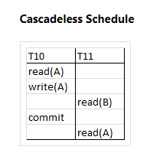
Cascadeless schedule
A cascadeless schedule is one where, for each pair of transactions Ti and Tj such that Tj reads a data item previously written by Ti , the commit operation of Ti appears before the read operation of Tj.
This type of schedule is called cascadeless schedule.

Slide 91
CONCURRENCY CONTROL IN DATABASES

Slide 92
CONCURRENCY CONTROL
When several transactions execute concurrently in the database, however, the isolation property may no longer be preserved.
To ensure it, the system must control the interaction among the concurrent transactions; this control is achieved through one of a variety of mechanisms called concurrency control schemes.
Concurrency control can be performed by the dbms with various methods such as locking methods, timestamp methods, etc.

Slide 93
Concurrency problems in DBMS Transactions
When multiple transactions execute concurrently in an uncontrolled or unrestricted manner, then it might lead to several problems.
These problems are commonly referred to as concurrency problems in database environment.

Slide 94
Lock based protocol
One way to achieve serializability is to access data items in a mutually exclusive manner.
That is ,when a transaction is accessing a data item no other transaction is allowed to modify that data item.
This can be achieved by holding a lock on the data item.

Slide 95
Locks
Modes in which a data item may be locked.
Shared mode
Exclusive mode
Shared mode
If a transaction Ti has obtained a shared –mode lock(denoted by S) on item Q, then Ti can read, but cannot write Q.
Any other transaction can obtain the same lock, on same data item at same time.
Denoted by Lock-S(Q)

Slide 96
Locks
Exclusive mode
If a transaction Ti has obtained an exclusive-mode lock(denoted by X) on item Q, then Ti can both read and write Q.
Any other transaction cannot obtain either exclusive/shared lock.
Denoted by lock –X(Q)

Slide 97
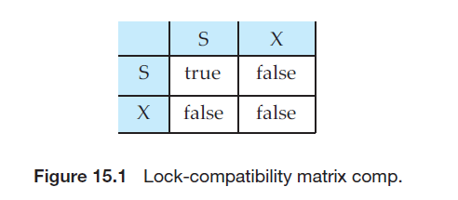
Lock compatibilty

Slide 98
A transaction requests a shared lock on data item Q by executing the lock-S(Q) instruction.
Similarly, a transaction requests an exclusive lock through the lock-X(Q) instruction.
A transaction can unlock a data item Q by the unlock(Q) instruction.
To access a data item, transaction Ti must first lock that item.

Slide 99
If the data item is already locked by another transaction in an incompatible mode, the concurrency control manager will not grant the lock until all incompatible locks held by other transactions have been released.
Thus, Ti is made to wait until all incompatible locks held by other transactions have been released.

Slide 100
Granting of locks
When a transaction requests a lock on a data item in a particular mode, and no other transaction has a lock on the same data item in a conflicting mode, the lock can be granted.
Some times a transaction may be starved.
We can avoid starvation of transaction by granting locks in the following manner.

Slide 101
When a transaction Ti requests a lock on a data item Q in a particular mode M, the concurrency-control manager grants the lock provided that,
1.There is no other transaction holding a lock on Q in a mode that conflict with M.
2.There is no other transaction that is waiting for a lock on Q and that made its lock request before Ti.

Slide 102
T1:lock-X(B); read (B); B:=B-50; write(B); unlock(B); lock-X(A); read(A); A:=A+50; write(A); unlock(A); | T2:lock-S(A) read(A) unlock(A) lock-S(B) read(B) unlock(B) display(A+B)

Slide 103
T1 | T2 | Concurency-cntrl manager
Lock-X(B) |  | Grant-X(B,T!)
Read(B) B:=B-50 Wite(B) Unlock(B)
 | Lock-S(A) | Grant-S(A,T2)
 | Read(A) Unlock(A) Lock-S(B)
 |  | Grant-S(B,T2)
 | Read B,unlock(B),display(A+B)
Lock-X(A) |  | Grant-X(A,T1)
Read(A) A:=A+50 Write(A) Unlock(A)

Slide 104
Two - Phase Locking (2PL)
Two-Phase locking protocol which is also known as a 2PL protocol.
This protocol ensures conflict serializability.
This protocol consists of 2 phases:
Growing phase
Shrinking phase

Slide 105
phases
Growing phase- A transaction may obtain locks but may not release any locks.
The point in schedule transaction had obtained its final lock is called locking point(end of growing phase.
Shrinking phase-A transaction may release locks but may not get any new locks in this phase.

Slide 106
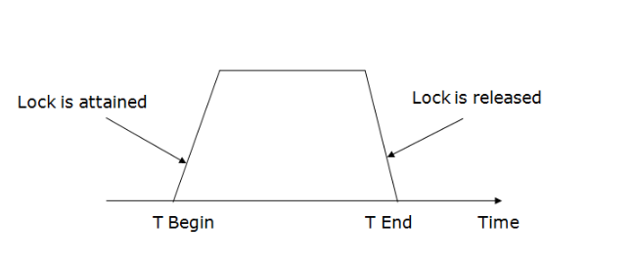
Initially transaction is in the growing phase.The transaction acquires locks as needed.
Once the transaction releases a lock it enters the shrinking phase and cannot issue any lock requests.

Slide 107
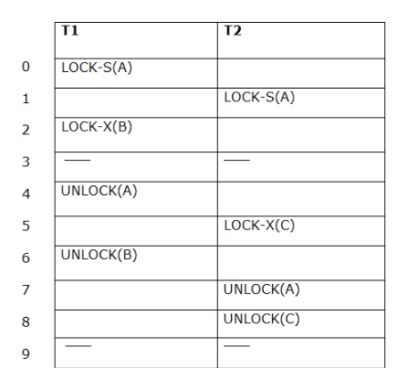
Example

Slide 108
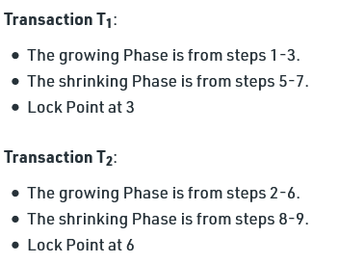

Slide 109
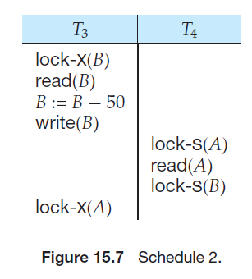
Two phase locking does not ensure freedom from deadlock.

Slide 110
Cascading rollback may occur under two-phase locking.
Cascading rollbacks can be avoided by a modification of two-phase locking called the strict two-phase locking protocol.

Slide 111
Deadlock in 2PL
T3 is holding an exclusive mode lock on B and T4 is requesting a shared-mode lock on B, T4 is waiting for T3 to unlock B.
Similarly, since T4 is holding a shared-mode lock on A and T3 is requesting an exclusive-mode lock on A, T3 is waiting for T4 to unlock A.
We have arrived at a state where neither of these transactions can ever proceed with its normal execution. This situation is called deadlock.
When deadlock occurs, the system must roll back one of the two transactions.

Slide 112
Deadlock are necessary evil associated with locking, if we want to prevent inconsistent states.
The first phase of Strict-2PL is same as 2PL. After acquiring all the locks in the first phase, the transaction continues to execute normally. But in contrast to 2PL, Strict-2PL does not release a lock after using it. Strict-2PL holds all the locks until the commit point and releases all the locks at a time

Slide 113
Concurrency Control Based on Timestamp Ordering
Another method for determining the serializability order is to select an ordering among transactions.
The most common method for doing so is to use a timestamp-ordering scheme.

Slide 114
TIMESTAMPS
With each transaction Ti in the system, we associate a unique fixed timestamp, denoted by TS(Ti ).
This timestamp is assigned by the database system before the transaction Ti starts execution.
If a transaction Ti has been assigned timestamp TS(Ti), and a new transaction Tj enters the system, then TS(Ti ) < TS(Tj ).

Slide 115
There are two simple methods for implementing this scheme:
Use the value of the system clock as the timestamp.A transaction’s timestamp is equal to the value of the clock when the transaction enters the system.
Use a logical counter that is incremented after a new timestamp has been assigned. A transaction’s timestamp is equal to the value of the counter when the transaction enters the system.

Slide 116
To implement this scheme, we associate with each data item Q two timestamp values:
W-timestamp(Q) denotes the largest timestamp of any transaction that executed write(Q) successfully.
R-timestamp(Q) denotes the largest timestamp of any transaction that executed read(Q) successfully.
These timestamps are updated whenever a new read(Q) or write(Q) instruction is executed.

Slide 117
The Timestamp-Ordering Protocol
The timestamp-ordering protocol ensures that any conflicting read and write operations are executed in timestamp order.
This protocol operates as follows:
1. Suppose that transaction Ti issues read(Q).
a. If TS(Ti )<W-timestamp(Q), then Ti needs to read a value of Q that was already overwritten. Hence, the read operation is rejected, and Ti is rolled back.
b. If TS(Ti )>=W-timestamp(Q), then read (Q) is executed and R-timestamp(Q) is set to the maximum of R-timestamp(Q) and TS(Ti ).

Slide 118
Timestamp-Ordering Protocol(conti..)
2. Suppose that transaction Ti issues write(Q).
a. If TS(Ti )< R-timestamp(Q) then the value of Q that Ti is producing was needed previously, and the system assumed that that value would never be produced. Hence, the system rejects the write operation and rolls Ti back.
b. If TS(Ti ) < W-timestamp(Q), then Ti is attempting to write an obsolete value of Q. Hence, the system rejects this write operation and rolls Ti back.
c. Otherwise, the system executes the write operation and sets W-timestamp( Q) to TS(Ti ).

Slide 119
Timestamp-Ordering Protocol(conti..)
If a transaction Ti is rolled back by the concurrency-control scheme as result of issuance of either a read or write operation, the system assigns it a new timestamp and restarts it.

Slide 120
The timestamp-ordering protocol ensures conflict serializability.
The protocol ensures freedom from deadlock, since no transaction ever waits.

Slide 121
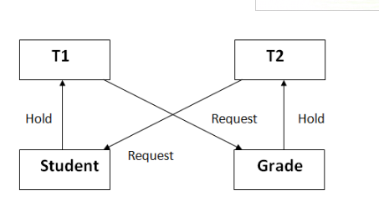
Deadlock
In a database, a deadlock is an unwanted situation in which two or more transactions are waiting indefinitely for one another to give up locks.

Slide 122
Deadlock Avoidance
When a database is stuck in a deadlock state, then it is better to avoid the database rather than aborting or restating the database.
This is a waste of time and resource.

Slide 123
Deadlock Detection
When a transaction waits indefinitely to obtain a lock, then the DBMS should detect whether the transaction is involved in a deadlock or not.
The lock manager maintains a Wait for the graph to detect the deadlock cycle in the database.

Slide 124
Wait for Graph
This is the suitable method for deadlock detection.
In this method, a graph is created based on the transaction and their lock.
If the created graph has a cycle or closed loop, then there is a deadlock.
The wait for the graph is maintained by the system for every transaction which is waiting for some data held by the others.
The system keeps checking the graph if there is any cycle in the graph.

Slide 125
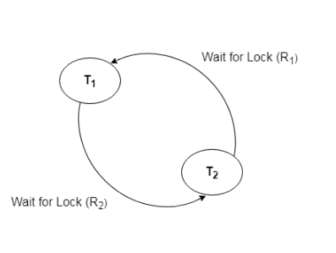
Wait for Graph

Slide 126
Deadlock Prevention
Deadlock prevention method is suitable for a large database.
If the resources are allocated in such a way that deadlock never occurs, then the deadlock can be prevented.
Two schemes for deadlock prevention:
Wait-Die scheme
Wound wait scheme

Slide 127
Wait-Die scheme
In this scheme, If a transaction requests a resource that is locked by another transaction, then the DBMS simply checks the timestamp of both transactions and allows the older transaction to wait until the resource is available for execution.
There are two transactions Ti and Tj and let TS(T) is a timestamp of any transaction T.
If T2 holds a lock by some other transaction and T1 is requesting for resources held by T2 then the following actions are performed by DBMS:

Slide 128
Wait-Die scheme
Check if TS(Ti) < TS(Tj) - If Ti is the older transaction and Tj has held some resource, then it allows T1 to wait until resource is available for execution. That means if a younger transaction has locked some resource and an older transaction is waiting for it, then an older transaction is allowed to wait for it till it is available
If T1 is an older transaction and has held some resource with it and if T2 is waiting for it, then T2 is killed and restarted later with random delay but with the same timestamp. i.e. if the older transaction has held some resource and the younger transaction waits for the resource, then the younger transaction is killed and restarted with a very minute delay with the same timestamp. This scheme allows the older transaction to wait but kills the younger one.

Slide 129
Wound wait scheme
In wound wait scheme, if the older transaction requests for a resource which is held by the younger transaction, then older transaction forces younger one to kill the transaction and release the resource. After the minute delay, the younger transaction is restarted but with the same timestamp.
If the older transaction has held a resource which is requested by the Younger transaction, then the younger transaction is asked to wait until older releases it.

Slide 130
Optimistic Methods for Concurrency Control
The optimistic method of concurrency control is based on the assumption that conflicts of database operations are rare and that it is better to let transactions run to completion and only check for conflicts before they commit.
An optimistic concurrency control method is also known as validation or certification methods.
No checking is done while the transaction is executing. The optimistic method does not require locking or timestamping techniques. Instead, a transaction is executed without restrictions until it is committed.

Slide 131
In optimistic methods, each transaction moves through the following phases:
Read phase.
Validation or certification phase.
Write phase.

Slide 132
(i) During read phase, the transaction reads the database, executes the needed computations and makes the updates to a private copy of the the database values. All update operations of the transactions are recorded in a temporary update file, which is not accessed by the remaining transactions.
(ii) During the validation phase, the transaction is validated to ensure that the changes made will not affect the integrity and consistency of the database. If the validation test is positive, the transaction goes to a write phase. If the validation test is negative, he transaction is restarted and the changes are discarded.
(iii) During the write phase, the changes are permanently applied to the database.

Slide 133
Database Recovery Management-Transaction Recovery
When a database fails it must possess the facilities for fast recovery.
There are both automatic and non-automatic ways for both, backing up of data and recovery from any failure situations.
The techniques used to recover the lost data due to system crash, transaction errors, viruses, catastrophic failure, incorrect commands execution etc. are database recovery techniques.
So to prevent data loss recovery techniques based on deferred update and immediate update or backing up data can be used.

Slide 134
Recovery techniques are heavily dependent upon the existence of a special file known as a system log.
It contains information about the start and end of each transaction and any updates which occur in the transaction.
The log keeps track of all transaction operations that affect the values of database items.
This information is needed to recover from transaction failure

Slide 135
The log is kept on disk start_transaction(T): This log entry records that transaction T starts the execution.
read_item(T, X): This log entry records that transaction T reads the value of database item X.
write_item(T, X, old_value, new_value): This log entry records that transaction T changes the value of the database item X from old_value to new_value. The old value is sometimes known as a before an image of X, and the new value is known as an afterimage of X.

Slide 136
commit(T): This log entry records that transaction T has completed all accesses to the database successfully and its effect can be committed (recorded permanently) to the database.
abort(T): This records that transaction T has been aborted
.checkpoint: Checkpoint is a mechanism where all the previous logs are removed from the system and stored permanently in a storage disk. Checkpoint declares a point before which the DBMS was in consistent state, and all the transactions were committed.

Slide 137
recovery process
Undoing – If a transaction crashes, then the recovery manager may undo transactions i.e. reverse the operations of a transaction. This involves examining a transaction for the log entry write_item(T, x, old_value, new_value) and setting the value of item x in the database to old-value.There are two major techniques for recovery from non-catastrophic transaction failures: deferred updates and immediate updates.

Slide 138
Deferred update – This technique does not physically update the database on disk until a transaction has reached its commit point. Before reaching commit, all transaction updates are recorded in the local transaction workspace. If a transaction fails before reaching its commit point, it will not have changed the database in any way so UNDO is not needed. It may be necessary to REDO the effect of the operations that are recorded in the local transaction workspace, because their effect may not yet have been written in the database. Hence, a deferred update is also known as the No-undo/redo algorithm

Slide 139
Immediate update – In the immediate update, the database may be updated by some operations of a transaction before the transaction reaches its commit point. However, these operations are recorded in a log on disk before they are applied to the database, making recovery still possible. If a transaction fails to reach its commit point, the effect of its operation must be undone i.e. the transaction must be rolled back hence we require both undo and redo. This technique is known as undo/redo algorithm.

Slide 140
Caching/Buffering – In this one or more disk pages that include data items to be updated are cached into main memory buffers and then updated in memory before being written back to disk. A collection of in-memory buffers called the DBMS cache is kept under control of DBMS for holding these buffers. A directory is used to keep track of which database items are in the buffer. A dirty bit is associated with each buffer, which is 0 if the buffer is not modified else 1 if modified.

Slide 141
Shadow paging – It provides atomicity and durability. A directory with n entries is constructed, where the ith entry points to the ith database page on the link. When a transaction began executing the current directory is copied into a shadow directory. When a page is to be modified, a shadow page is allocated in which changes are made and when it is ready to become durable, all pages that refer to original are updated to refer new replacement page.

